Slide 1
Examination System

Slide 2
Team Members
Omnia Saleh Hamida
Omnia Nasser Abd El-Fattah
Hager Abas Eissa
Shaimaa Abd Allah Ahmed
Aya Mahmoud Mohammed
Gehad Radwan Ahmed

Slide 3
Agenda
Introduction
Tools and Languages
Creation Database
Stored procedures
Examination System Application
Reports
Power BI Dashboards

Slide 4
Introduction
Examination System needs less manpower handle examination as it Generates Exams, and Organizations can also easily monitor.
The analysis of the system helps managers to take decisions for developing the organization.

Slide 5
Tools and Languages
SSMS For Database
Drawio for creating ERD
RedGate(sql data Generator), Excel and Python for filling tables
SSRS For Reports
Power BI For Dashboards
C# For Application

Slide 6
Database
Tables: Intakes, Tracks, Students , Instructors, Courses, Topics, Exams, Questions, Choices, Certifications, Freelancing, Hiring, and the user registration data.
It also hold tables of the relationships between the previous entities.

Slide 7
Stored procedures
Select, Insert, update and delete of tables
Exam generation
Exam Answers
Exam Correction

Slide 8
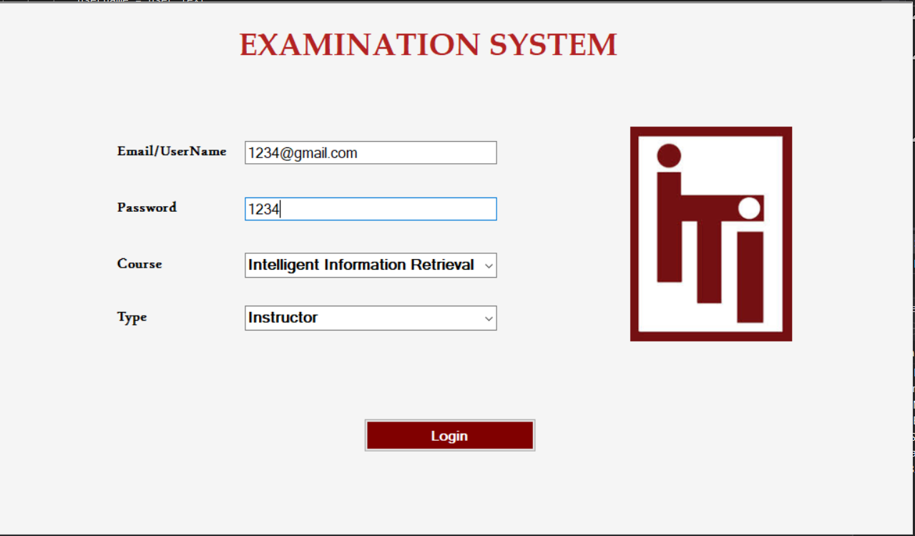
Examination System Application

Slide 9
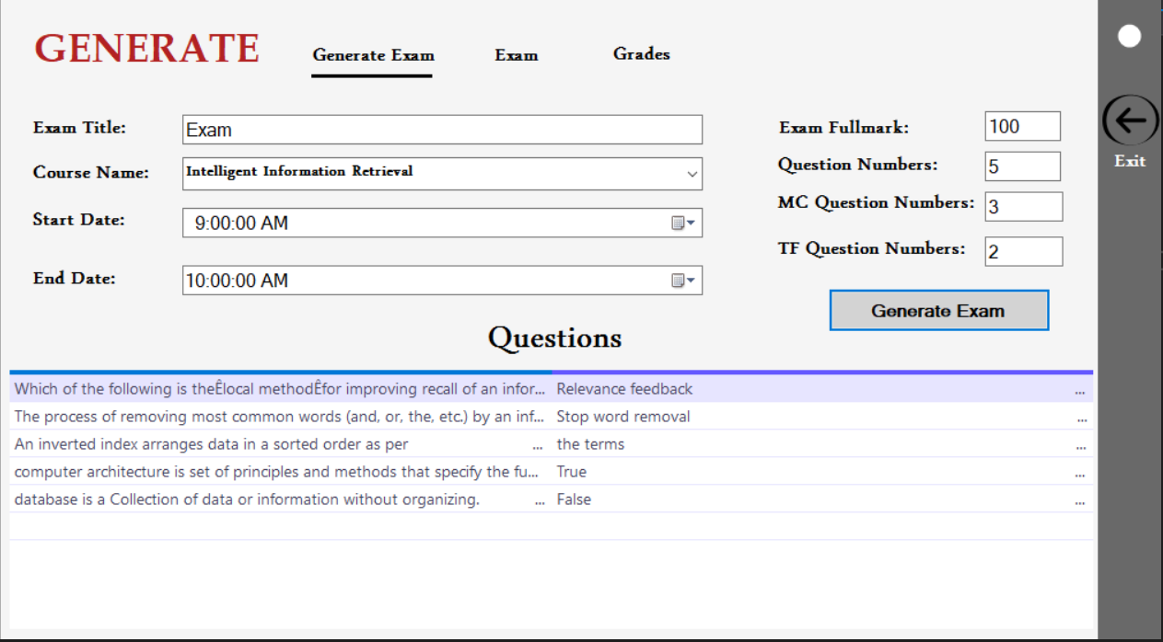
Examination System Application

Slide 10
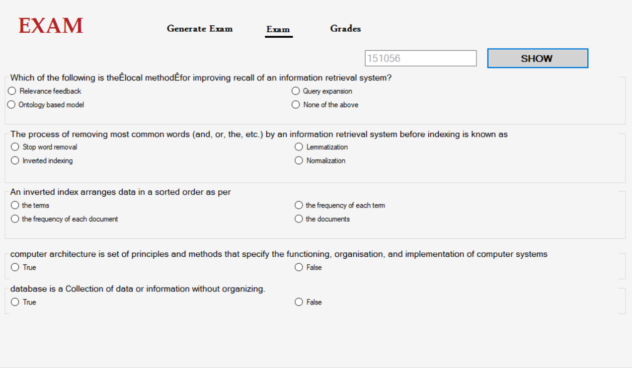
Examination System Application

Slide 11
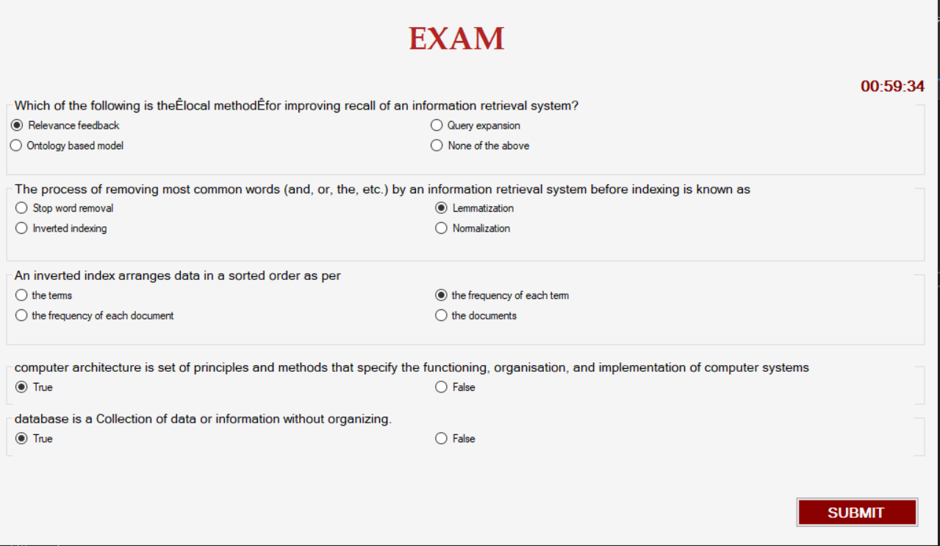
Examination System Application

Slide 12
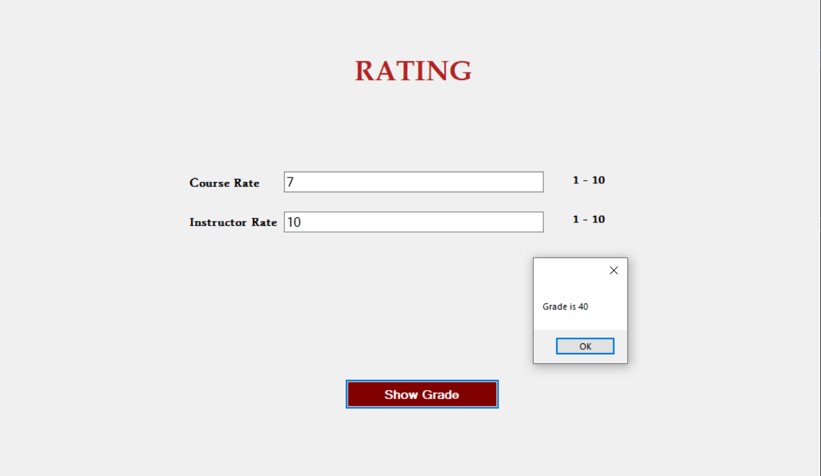
Examination System Application

Slide 13
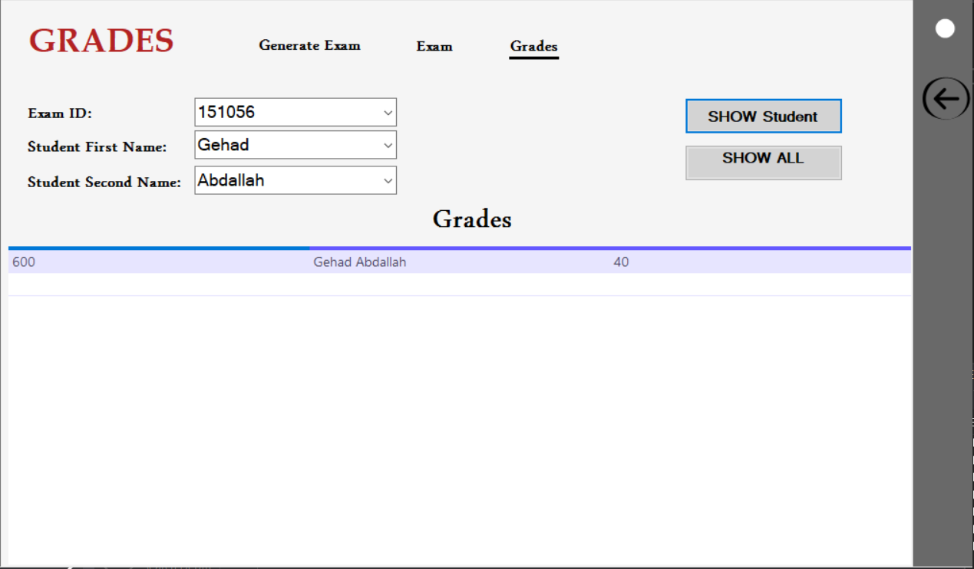
Examination System Application

Slide 14
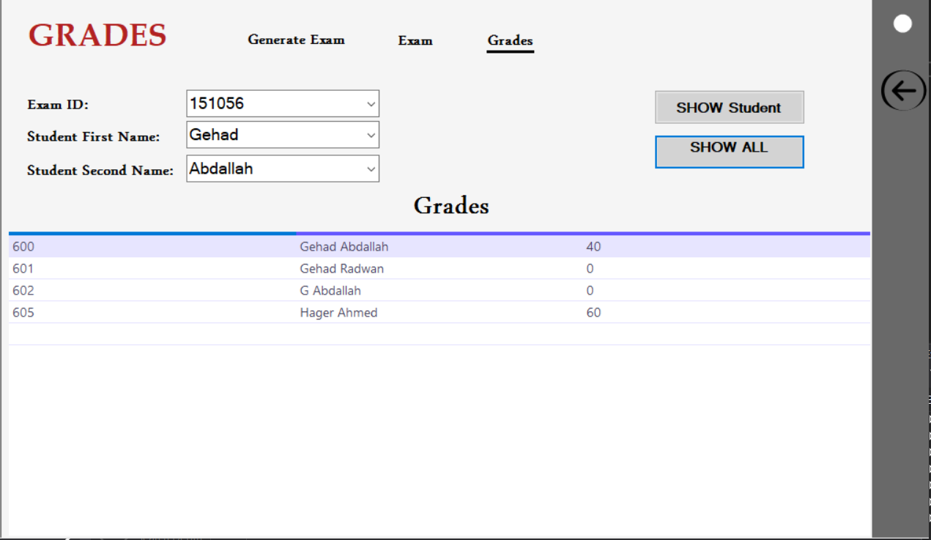
Examination System Application

Slide 15
Reports

Slide 16
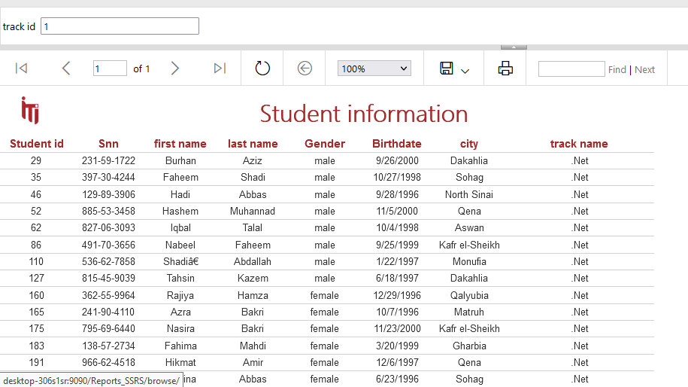
1- Takes Track number and returns the students information

Slide 17
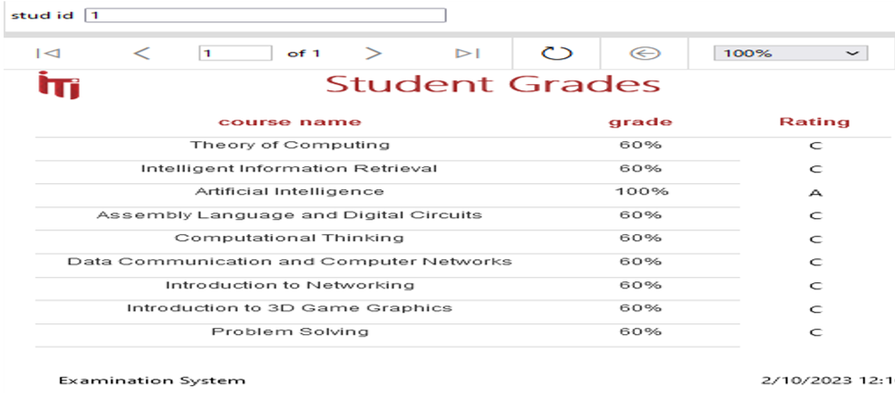
2- Takes the student ID and returns the grades of the student in all courses %

Slide 18
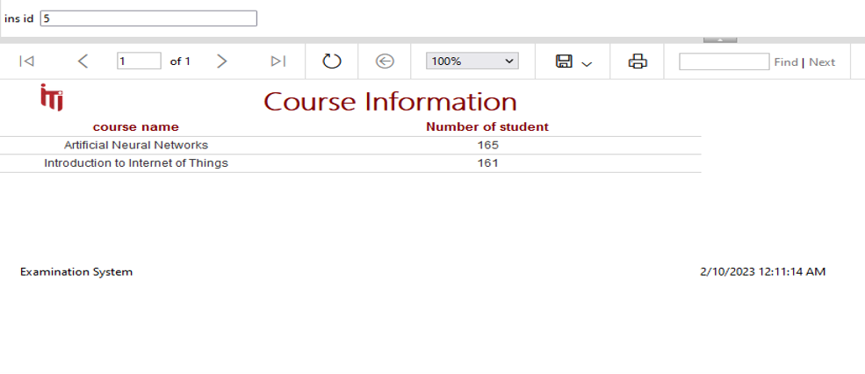
3- Takes the instructor ID and returns the name of the courses that he teaches and the number of student per course.

Slide 19
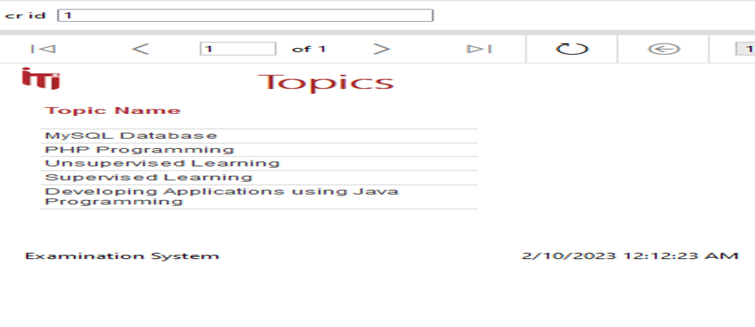
4- Takes course ID and returns its topics

Slide 20
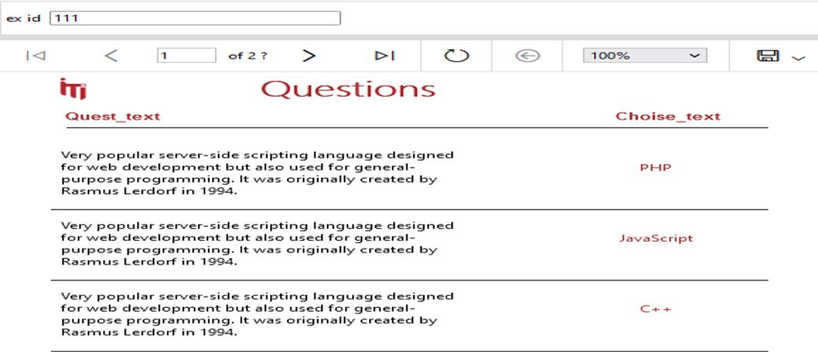
5- Takes exam number and returns the Questions in it and choices (free form)

Slide 21
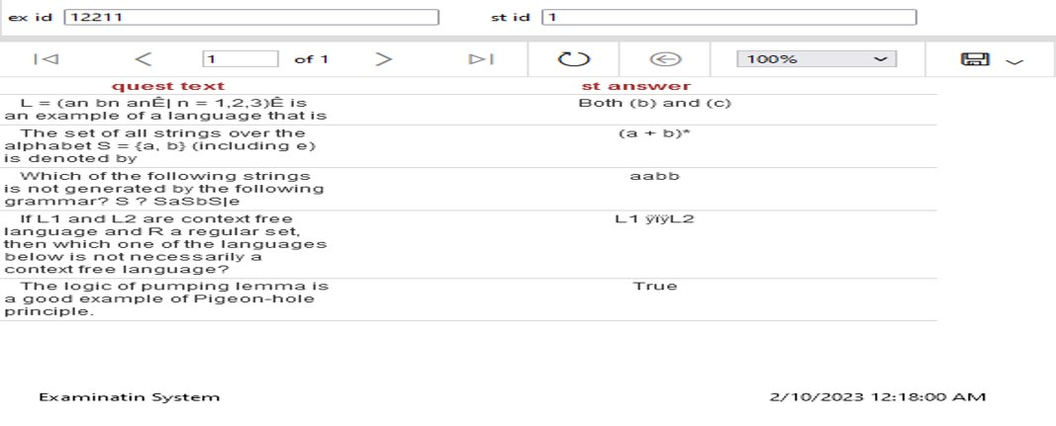
6- Takes exam number and the student ID then returns the Questions in this exam with the student answers.

Slide 22
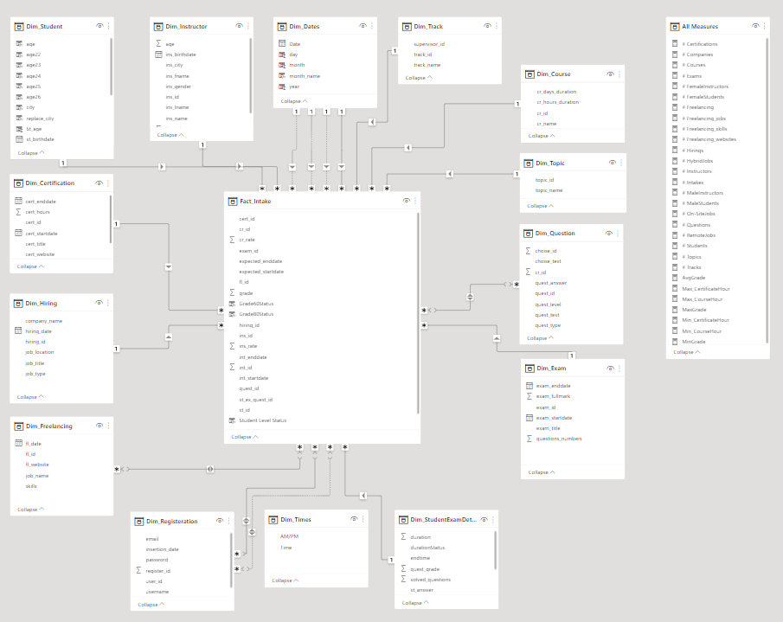
Data Warehouse

Slide 23
Dashboards
It helps to answer some questions that provide managers with information to take decisions for developing the organization.

Slide 24
Questions
Does the number of students increase?
Do the organization need a new branches?
The most Tracks the students register in ?
Do we need to change instructors?
Do we need to change the content of courses based on grades?
Does ITI qualify students to labor market?

Slide 25
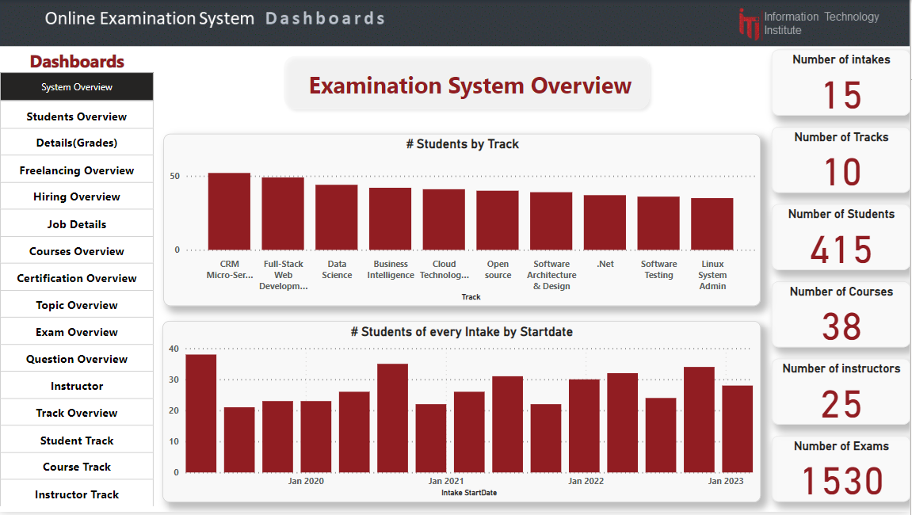
Power BI Dashboards

Slide 26
Conclusion
With the completion of this project, we conclude that it has achieved its purpose. The whole project provides a Desktop Application for students to take their exam and allows Instructors to Generate Exams randomly.
The analysis of the system helps managers to take decisions for developing the organization.

Slide 27
Thank You!

